Slide 1
Higg BRM 2021
Practical support
BRM Zalando cadence - webinar #4
April 5th 2022

Slide 2
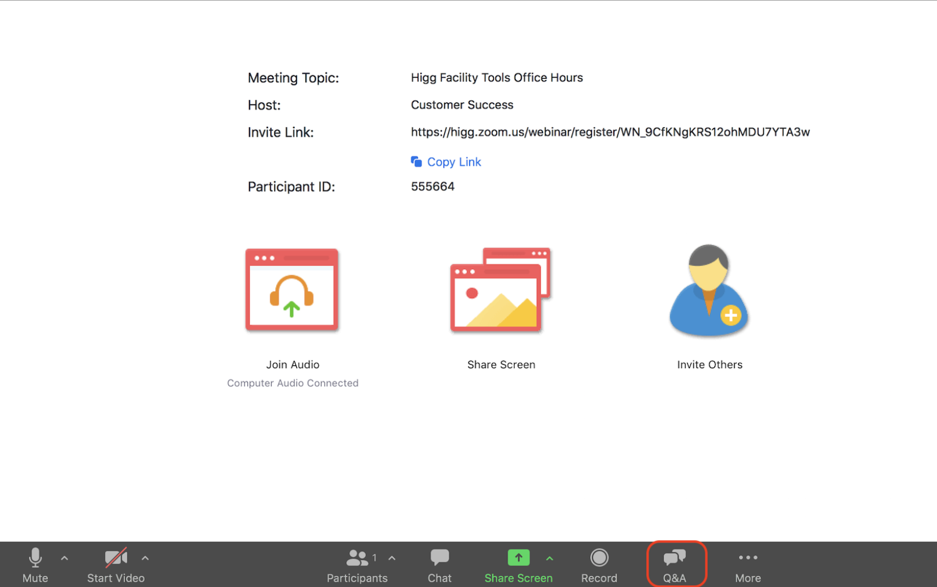
Logistics
Attendees will be muted for duration of webinar.
The webinar will be recorded and the recording will be shared after.
Please submit questions
through Q&A box.
We will NOT answer questions submitted through the chat box.
Notes:
Before we get started, a few logistical things I want to cover.
Attendees will be muted for the duration of the call, however you are able to submit a question at any time through the Q&A button on the panel. Please make sure to use the Q&A box, NOT the chat box as things can get lost in the chat. We will answer your question when we have a break or at the end of the presentation.
Additionally, this session is being recorded and we will share the recording after in an email sent to to the email address you used to register for the session with. It will also be posted on Howtohigg.org.
With that lets start the recording & dive into this session.

Slide 3
Higg
Agenda
1
2
3
4
5
BRM - Context
One more thing!
Practical support
Q&A
Timeline & resources
Notes:
This is the agenda for todays session. We’ll start with an introduction and some background on Higg and the Higg tool, then we will go through each of those tools in a bit more detail. We will also cover how you use and understand the data you have collected, and then end with a live platform demo. We will also take a few breaks and spend any time at the end to answer questions.

Slide 4
BRM - Context
Notes:
We’ll get started with the introduction.

Slide 5
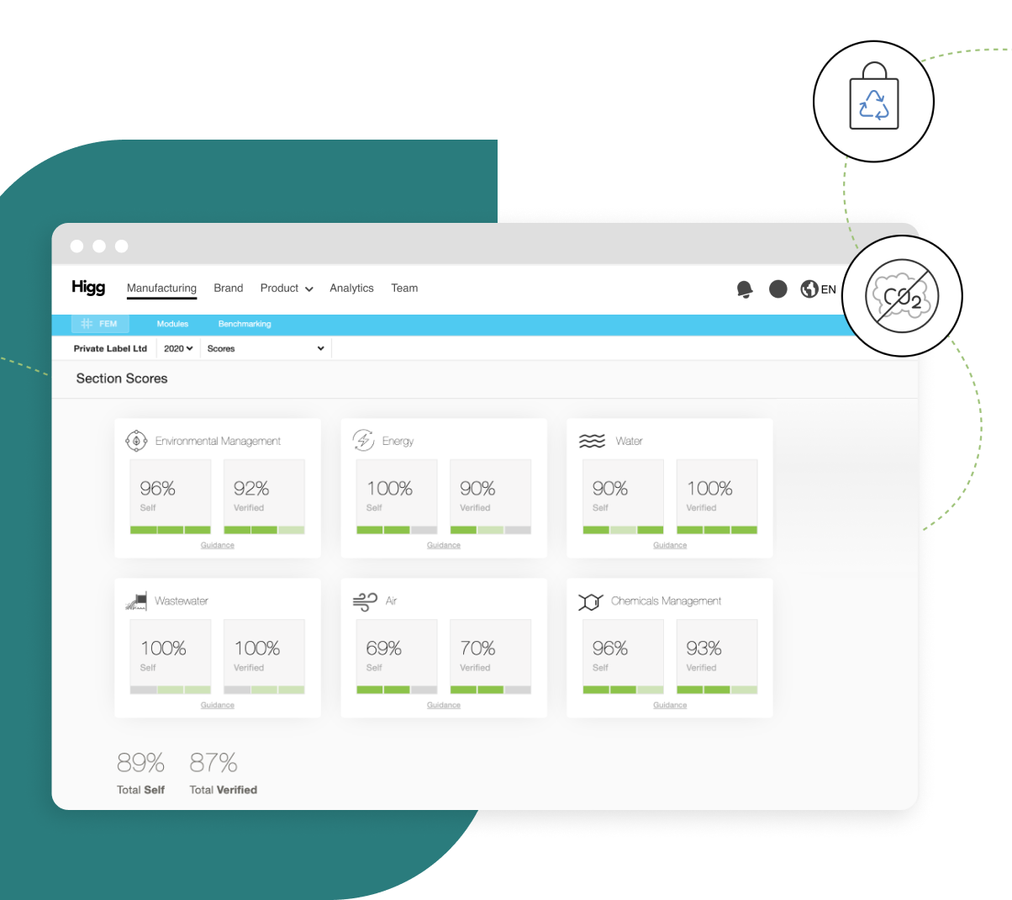
BRM - Context
Higg BRM is NOT a pass or fail exercise
Higg BRM helps you understand where to take action by establishing a baseline for where you are in your sustainability journey. This is a process of engagement and continuous improvement.
Notes:
So I’ll repeat this: You will not fail and most importantly Zalando will not penalise you – this is a benchmark and it’s going to help with moving the process forward.
“It’s ok if you don’t have all the answers.
Using the BRM, finishing the assessment is not a pass or fail exercise.
Yes its good to have a higher score but it’s even better if over time you can improve a low score
Which then enables them to take decisive action to improve their impact
To choose suppliers that produce fewer emissions
Materials that consume less water
Or to design products for reduced impact, all the way to end-of-use
Through the datasets we provide, or new data we help businesses gather, Higg empowers our customers to advance continuous improvement in all parts of their business...

Slide 6
BRM - Context
Preparation is essential
Higg BRM typically takes about 6-8 weeks to complete. Much of the work lies in gathering the data to populate the tool. It’s not so dissimilar from planning how to summit a peak; your prep work will pay off once it’s time to climb.
Notes:
The founding intent of the BRM was as a performance management tool
Scoring was created for this purpose - to help you to prioritize areas for action.
It’s a pointer to what you’re good at but more interestingly it’s also a pointer to where you need to improve.
I also want to speak quickly about the Higg index scoring guidelines:
Scores are out of 100 points
We Only rewards for positive attributes. So please don’t be concerned if there are questions where you answer No
And by the way, this is the type of score we expect to see from the low 20 to the high 80’s

Slide 7
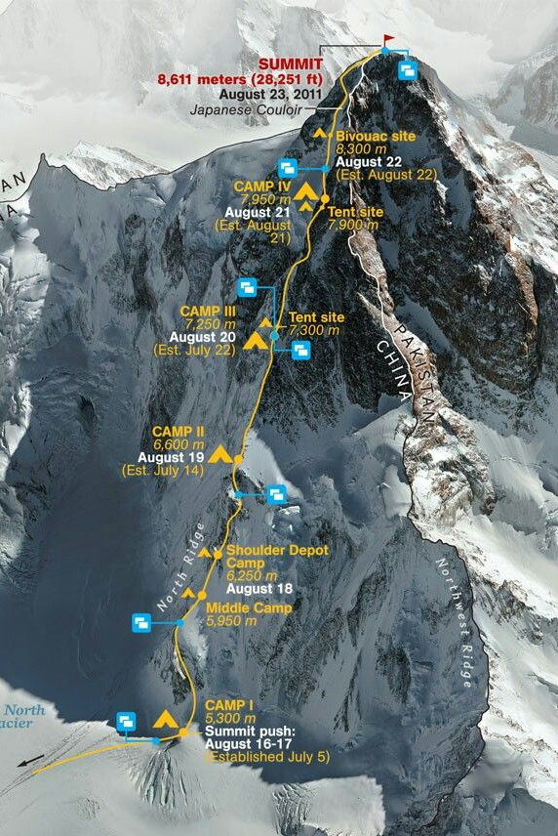
BRM - Context
Scoring to help you prioritize
Higg BRM is an annual evaluation
All questions “only” refer to the 2021 exercise. Please keep this is in mind when answering.
Notes:
Reminder: Company profile is the 1st thing you need to complete
Map what information you have & don’t have
Identify which person is responsible for each type of information (whether you have it or not)
Reach out to that person (reach out individually or do a kick-off meeting?)
Get the information & organize it (in the BRM excel file, in the data collection sheets)
- Supply chain mapping
- Risk assessment
- Material tracking
Complete the BRM self-asessment
Weekly touch-base on project advancement

Slide 8
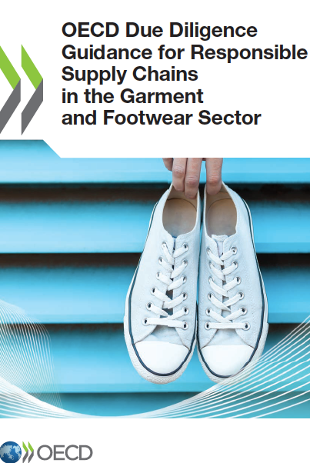
BRM - Context
Due Diligence as a legal requirement
EU Sustainable Corporate Governance Initiative
German Act on Corporate Due Diligence in Supply Chains
UK Modern Slavery Act §54
Dutch Child Labour Due Diligence Law
French Corporate Duty of Vigilance Law
California Transparency in Supply Chains Act
Notes:
Which then enables them to take decisive action to improve their impact
To choose suppliers that produce fewer emissions
Materials that consume less water
Or to design products for reduced impact, all the way to end-of-use
Through the datasets we provide, or new data we help businesses gather, Higg empowers our customers to advance continuous improvement in all parts of their business...

Slide 9
One more thing!
Notes:
We’ll get started with the introduction.

Slide 10
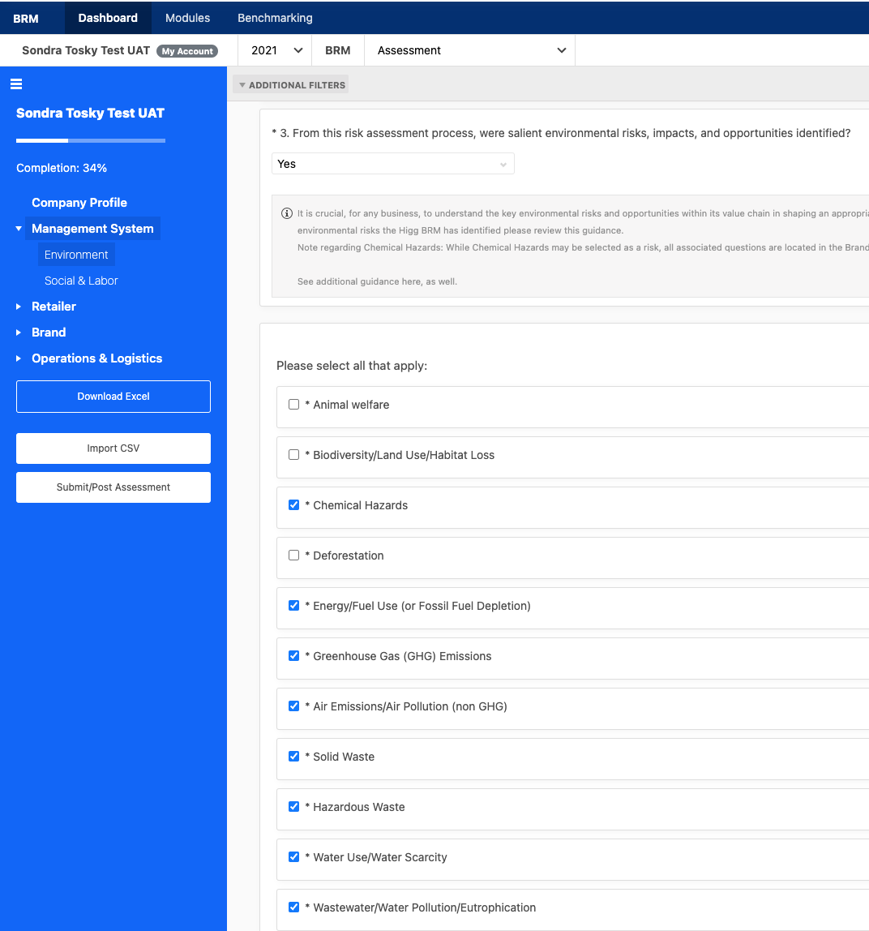
Higg BRM 2021 | One more thing!
BRM Risk assessment
One more thing!
For the sake of comparability & alignment with Zalando’s internal Code Of Conduct, please select the following risks in the list provided in the BRM - Management system - Environment section
Notes:
Another way to look at the tools is in terms of carbon accounting.
One track is really deeply engaging with your factories and looking at it through a supplier emissions lens. That's using the FEM to understand each of your factories and supply chain partners Greenhouse gas emissions and then also through that brand and retail module to understand things like your transportation choices, your retail and office spaces, and things like that.
If, instead, you want to focus on the product side, doing full product material modeling using the MSI and product module allow you to understand the carbon consequences of the material choices that you're making the dyes or finishes or any of the production processes And how those decisions in the design process are impacting things like carbon emissions.

Slide 11
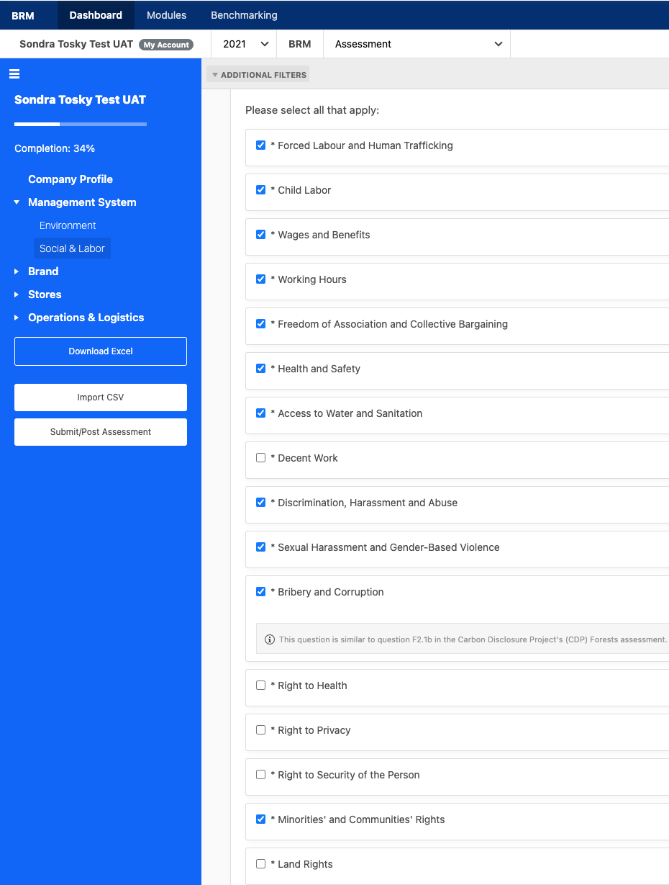
Higg BRM 2021 | One more thing!
BRM Risk assessment
One more thing!
For the sake of comparability & alignment with Zalando’s internal Code Of Conduct, please select the following risks in the list provided in the BRM - Management system - Social & labor section
Notes:
Another way to look at the tools is in terms of carbon accounting.
One track is really deeply engaging with your factories and looking at it through a supplier emissions lens. That's using the FEM to understand each of your factories and supply chain partners Greenhouse gas emissions and then also through that brand and retail module to understand things like your transportation choices, your retail and office spaces, and things like that.
If, instead, you want to focus on the product side, doing full product material modeling using the MSI and product module allow you to understand the carbon consequences of the material choices that you're making the dyes or finishes or any of the production processes And how those decisions in the design process are impacting things like carbon emissions.

Slide 12
Practical support
Notes:
We’ll get started with the introduction.

Slide 13
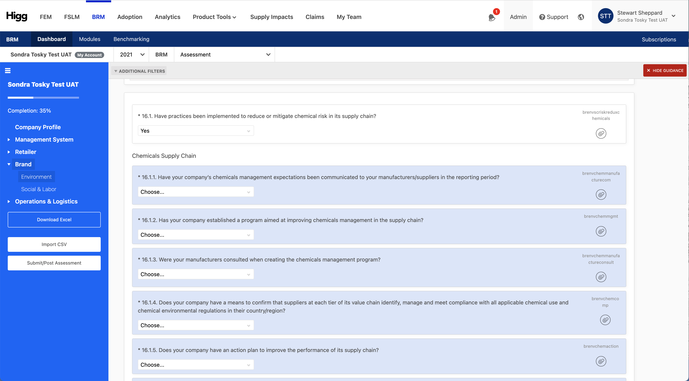
Higg BRM 2021 | Practical support
Notes:
So based on the information I just shared, if you can’t answer yes to question #1 you cannot answer yes to question #2.
If you did answer yes to question #1 then question #2 is all about using the information you have from your operations and supply chain maps to evaluate where you have risk.

Slide 14
Practical support
Meet bob: Robert ‘Bob’ Buck
Technical fellow at Chemours.
PhD in Chemistry
Member of the board of directors at the SAC from 2014 to 2017
Author of 99 published papers
Who is your “bob”?
Notes:
Which then enables them to take decisive action to improve their impact
To choose suppliers that produce fewer emissions
Materials that consume less water
Or to design products for reduced impact, all the way to end-of-use
Through the datasets we provide, or new data we help businesses gather, Higg empowers our customers to advance continuous improvement in all parts of their business...

Slide 15
Higg BRM 2021 | Practical support
Is it a process or is it an individual?
Is it a process, or is it an individual?
Ask yourself whether this is a “one off”?
Does this tracking happen only because of Bob’s interest and expertise?
What would happen if “Bob” left?
Is it a process or is it circumstantial?
Is it a process or a programme?
Is there a process for this? -> Yes/No
Is there a stated goal, e.g.: reduce the use of x? Yes/No
Is there a target, e.g.: reduce use of x to Zero by 2025? Yes/No
What is your baseline (year & amount)?
If you can answer “Yes” to all of these, then it’s a programme
Notes:
Another way to look at the tools is in terms of carbon accounting.
One track is really deeply engaging with your factories and looking at it through a supplier emissions lens. That's using the FEM to understand each of your factories and supply chain partners Greenhouse gas emissions and then also through that brand and retail module to understand things like your transportation choices, your retail and office spaces, and things like that.
If, instead, you want to focus on the product side, doing full product material modeling using the MSI and product module allow you to understand the carbon consequences of the material choices that you're making the dyes or finishes or any of the production processes And how those decisions in the design process are impacting things like carbon emissions.

Slide 16
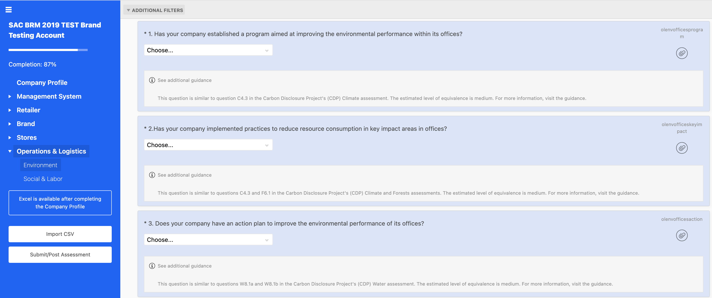
Higg BRM 2021 | Practical support
Notes:
Typically, this question is targeted directly at SME’s that might not have a full environmental program but are tackling environmental issues at their level.
What we want to understand is: Do you have a structured approach for improving the environmental performance of your stores?

Slide 17
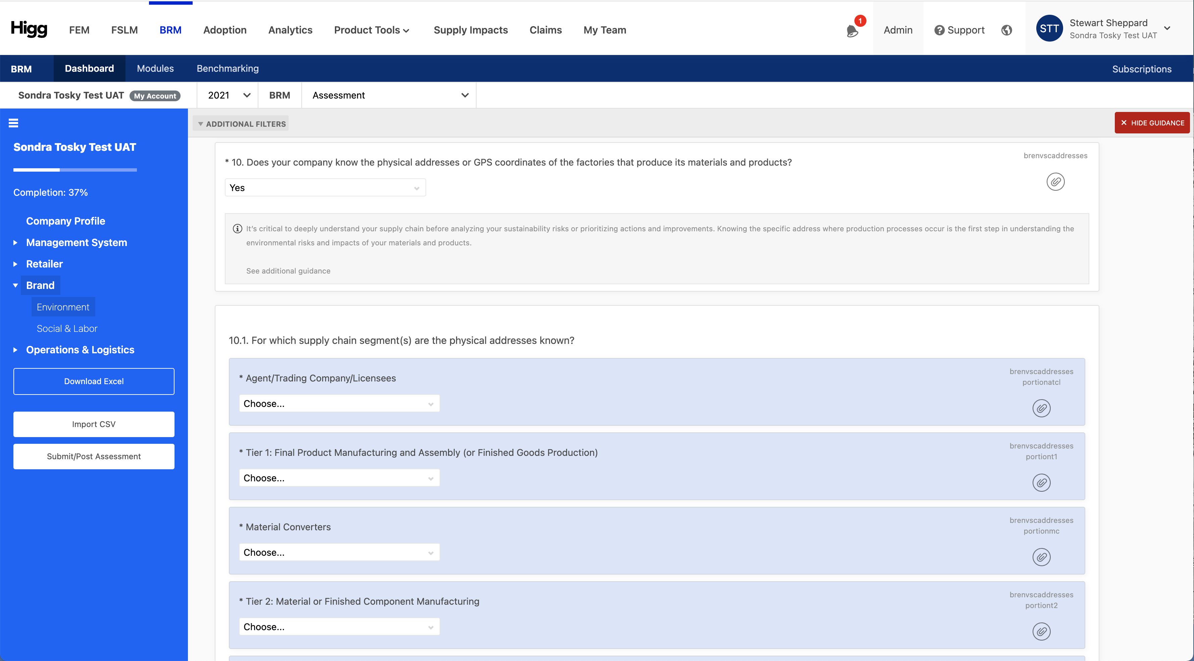
Higg BRM 2021 | Practical support
Notes:
Kind if random (or not?)
Just checking that if you answer No to this one then you should not have answered Yes to any of the supply chain mapping questions (Management Systems, environment & Social #3)

Slide 18
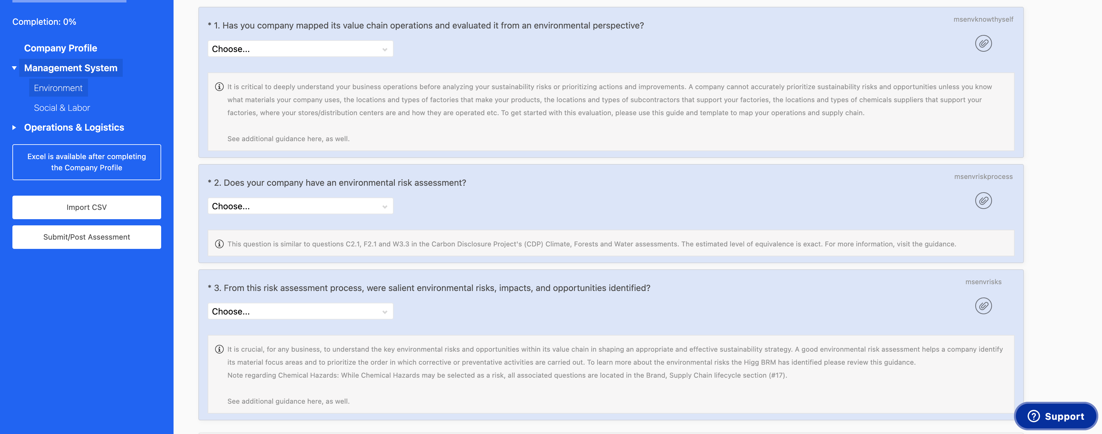
Higg BRM 2021 | Practical support
Notes:
This is the first question in the first “section” of the tool.
Read the question
What that means is

Slide 19
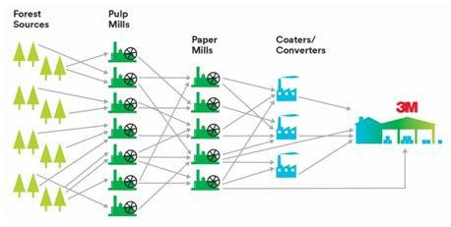
Higg BRM 2021 | Practical support
Notes:
Mapping your supply chain starts with listing all the suppliers that you have direct business relationships with and what products and services they provide to your company.
That includes the countries you operate in (how many? Where?): number of countries x facilities = multiplication of risks!!!
A good place to start is your sourcing managers, purchasing agents, facilities managers, field staff and buyers.

Slide 20
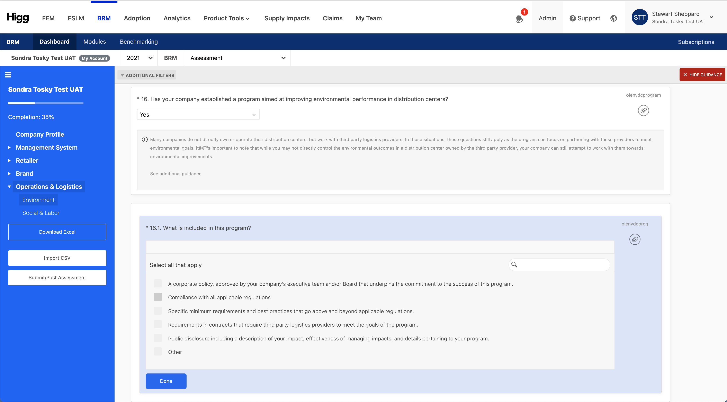
Higg BRM 2021 | Practical support
Notes:
So based on the information I just shared, if you can’t answer yes to question #1 you cannot answer yes to question #2.
If you did answer yes to question #1 then question #2 is all about using the information you have from your operations and supply chain maps to evaluate where you have risk.

Slide 21
Practical support
Many companies do not directly own or operate their distribution centres, but work with third party logistics providers.
In those situations, these questions still apply as the program can focus on partnering with these providers to meet environmental goals. It’s important to note that while you may not directly control the environmental outcomes in a distribution centre owned by the third-party provider, your company can still attempt to work with them towards environmental improvements.
Notes:
Which then enables them to take decisive action to improve their impact
To choose suppliers that produce fewer emissions
Materials that consume less water
Or to design products for reduced impact, all the way to end-of-use
Through the datasets we provide, or new data we help businesses gather, Higg empowers our customers to advance continuous improvement in all parts of their business...

Slide 22
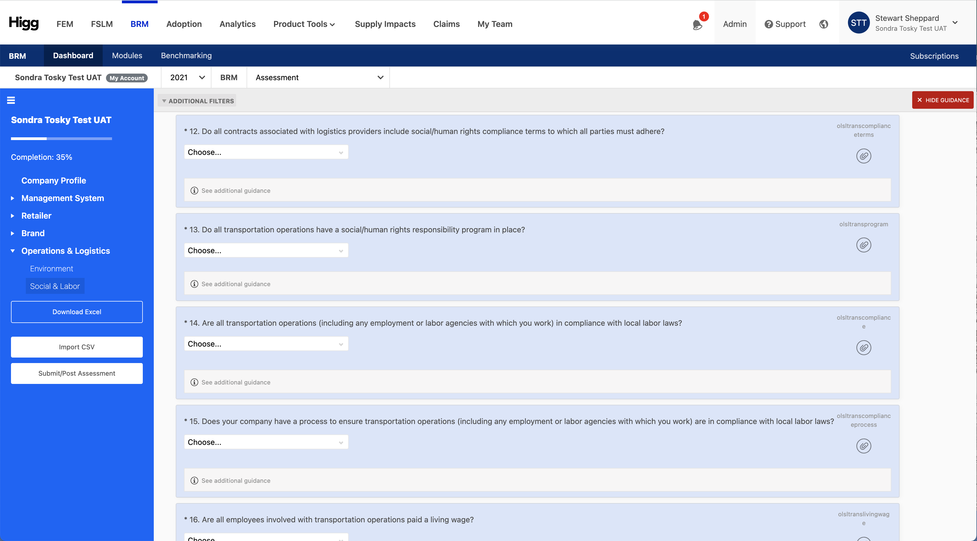
Higg BRM 2021 | Practical support
Notes:
So based on the information I just shared, if you can’t answer yes to question #1 you cannot answer yes to question #2.
If you did answer yes to question #1 then question #2 is all about using the information you have from your operations and supply chain maps to evaluate where you have risk.

Slide 23
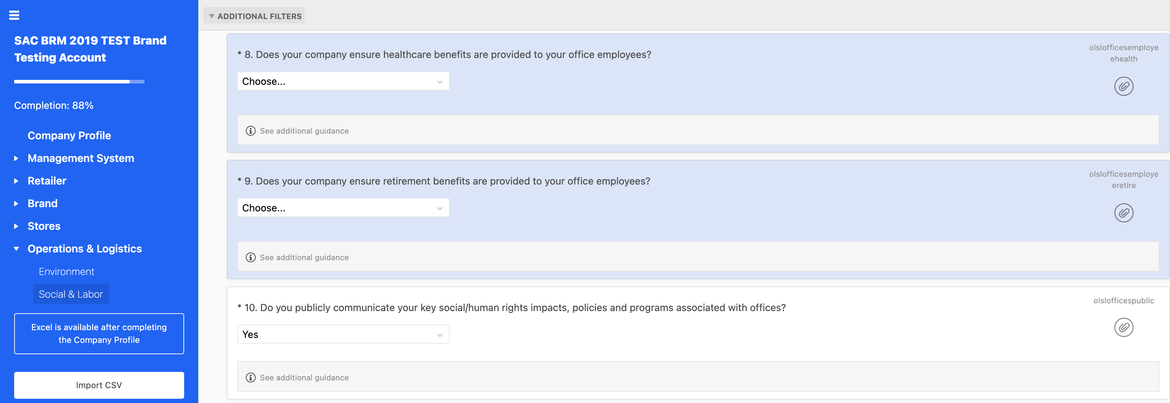
Higg BRM 2021 | Practical support
Notes:
This is a more US-specific focus point here; for companies operating in countries where it is compulsory to provide social security & retirement benefits, and/or these benefits are provided by the state, please answer Yes.

Slide 24
Q&A

Slide 25
BRM timeline & resources
Notes:
And with that, we’ll move on to focusing on each tool in a little bit more detail, starting with our measurement tools.

Slide 26
BRM 2021 | timeline & resources
March 1st
June 30th
Feb
Introduction + create your account webinar
March
BRM access available
Webinar
Support
April
Continued support
Webinar
Office hours
Support
May
Continued Support
Webinar
Office hours
Support
June
Continued Support
Webinar
Support

Slide 27
Introduction | BRM 2021 timeline & resources
01
Specific help pages : https://howtohigg.org/zalando-brand-engagement-2021/
Direct contact : izzy.joly@higg.com
02
Webinars & office hours:
April 26th
May 17th , June 7th
June 21st
03

Slide 28
BRM 2021 | Additional Training Resources
Howtohigg.org
Support team
Higg training website available for free to all users
Detailed written and video guidance support
H2H content guides, which go question by question through the assessments
Upcoming training events and previously recorded webinars
Available daily for any questions, including purchasing and account management, module completion, etc.
Available in 4 languages
  English
  Spanish
  Chinese
  Portuguese
Submit a ticket here: howtohigg.org/request
Notes:
If you need to support outside of the planned webinars, you have two additional training resources.
The first is our training site, howtohigg.org. This is available for free to all users at any time, and is full of all the information you could need about any of our tools. This includes detailed written guidance as well as video walk throughs for all the tools, as well as our question by question guides, called the How to Higg guide for each of our assessment tools (which are the FEM, FSLM and BRM, which we will cover shortly). We also have a calendar with all the upcoming training webinars and information on how to register, and previously hosted webinar recordings which you can view at any time. We have hosted a ton of training sessions this year so if you don’t see an upcoming session check the recorded webinars for more learning resources.
The second resource is our customer support team. They’re available for you to submit a ticket 24/7, for any type question you may have from account management and purchasing a module to a question about a specific sustainability concept in one of our tools. They are available in the language you can see on the screen. You can submit a ticket at howtohigg.org/request or through the button on our platform that I will show during the platform demo.

Slide 29
Higg | Opportunities
01
02
03
04
You will not fail
Scoring is just one insight
Preparation is essential
Due Diligence
This is about establishing a baseline and working towards continuous improvement.
The tool is designed to help you move beyond the score.
Understand risk areas and opportunities for improvement.
This is not a “quick & dirty” evaluation.
The usefulness of the assessment is directly correlated to its scope
Old & new Due Diligence requirements creating a renewed demand for insights into brand’s supply chains

Slide 30
Thank You!
Notes:
With that I will take a minute and see if we have any questions, and if not, move on to the platform demo!

